Slide 1


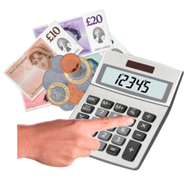

Gender Pay Gap Report
Notes:
This is a simple 4 page easy read booklet. You can place your logo in the top right picture box, next to the EasyRead logo. Choose a main picture that helps show what the booklet is about. Then choose another picture to match the text you write below.

Slide 2

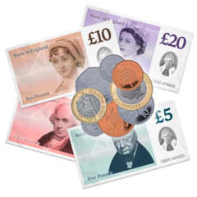

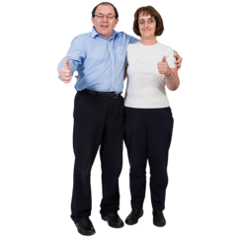
This is Walsingham Support’s
Gender Pay Gap Report.
The gender pay gap is the difference between the pay of male and female staff.
The government has asked organisations that have more than 250 staff to write their own report.
Walsingham Support believe that men and women who do the same job should get paid the same.
2
Notes:
Write your title and text. Then change the placeholder pictures to match your words.

Slide 3



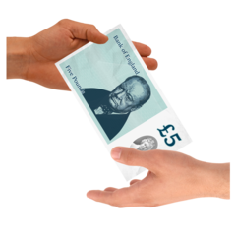
Walsingham Support employs 825 women and 247 men.
Women earn 4.5% lower than men on average at Walsingham Support.
Overall, we are doing well compared to the national average, which is 17.1%.
More women than men got bonuses.
3
Notes:
Write your title and text. Then change the placeholder pictures to match your words.

Slide 4




There are twice as many women as men in the senior leadership team.
This is a good thing as it means our leadership team represents our staff.
Walsingham Support have to write a gender pay gap report once a year.
We will continue to ensure men and women receive equal pay for equal work.
4
Notes:
Write your title and text. Then change the placeholder pictures to match your words.

Slide 5

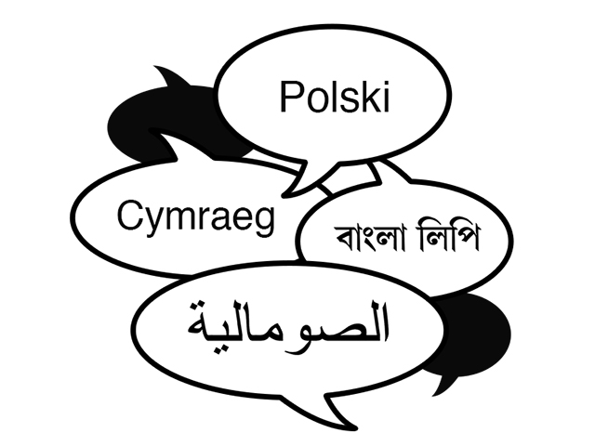
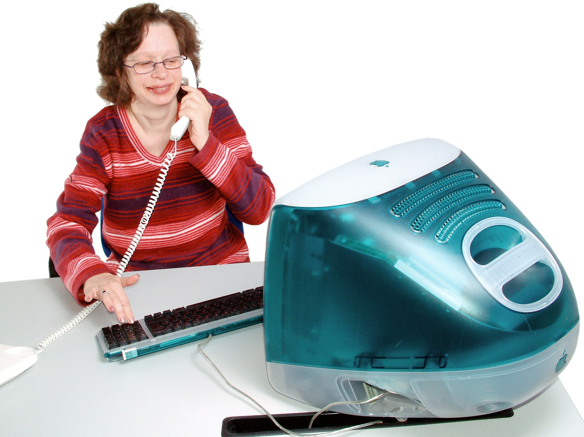



Contact us
Tell us if you would like this information on a CD.
Tell us if you would like this information in a different language.
Contact us
If you have any questions about this document you can contact us.
Suite 500, 1st Floor Building 4
North London Business Park, London N11 1GN
020 8343 5600
enquiries@Walsingham.com
www.walsingham.com
Notes:
Write your title and text. Then change the placeholder pictures to match your words.

